Slide 1
Control System (ECE305)
Dr.Anuj Jain
Professor (SEEE,LPU)

Slide 2
Open loop control system :--

Slide 3
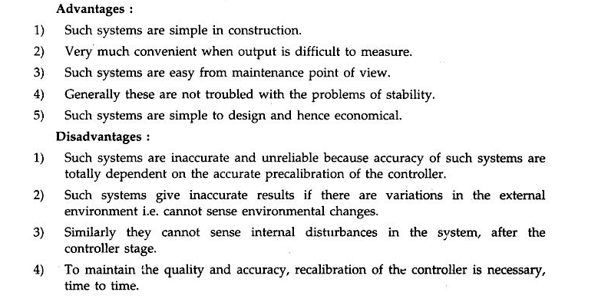
Advantage and Disadvantage of open loop system:---
https://www.youtube.com/watch?v=f32SDx3C6sA

Slide 4
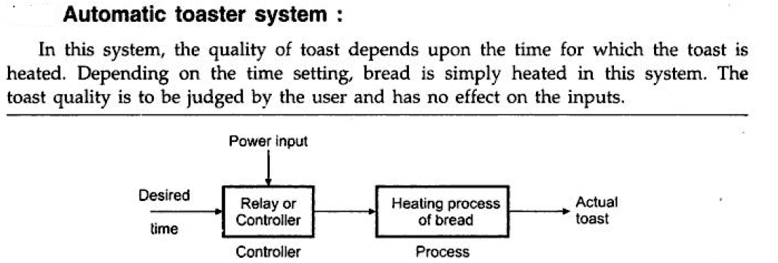
Example of Open loop control system

Slide 5
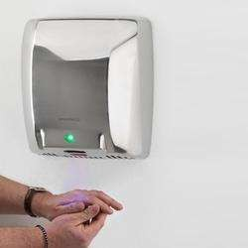
OLCS Examples
Electric hand drier – Hot air (output) comes out as long as you keep your hand under the machine, irrespective of how much your hand is dried.
5

Slide 6
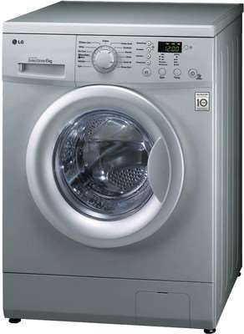
Automatic washing machine
– This machine runs according to the pre-set time irrespective of washing is completed or not.
6

Slide 7
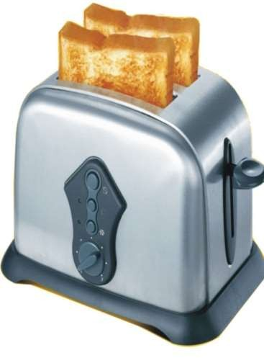
OLCS Examples
Bread toaster | - | This
machine runs | as | per
adjusted |  | time
irrespective of toasting is completed or not.

Slide 8
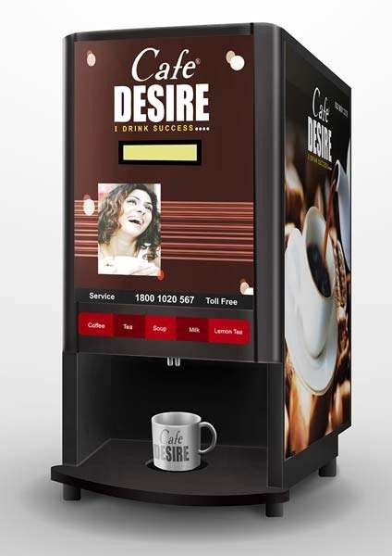
OLCS Examples
Automatic tea/coffee Vending Machine – These machines also function for pre adjusted time only.

Slide 9
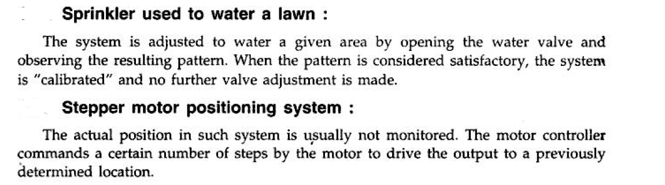
OLCS Examples

Slide 10
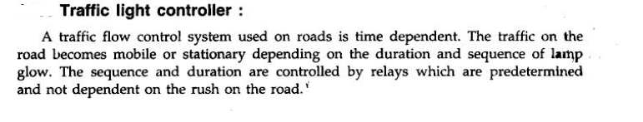
OLCS Examples

Slide 11
For open control system which of the following statements is incorrect ?
(a) Less expensive
(b) Recalibration is not required for maintaining the required quality of the output
(c) Construction is simple and maintenance easy
(d) Errors are caused by disturbances

Slide 12
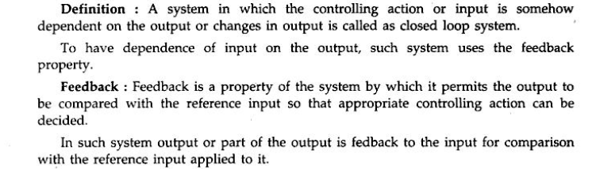
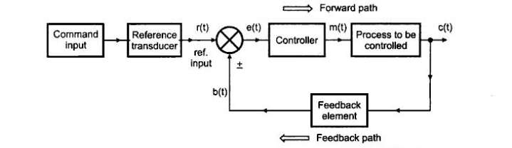
Closed loop system

Slide 13
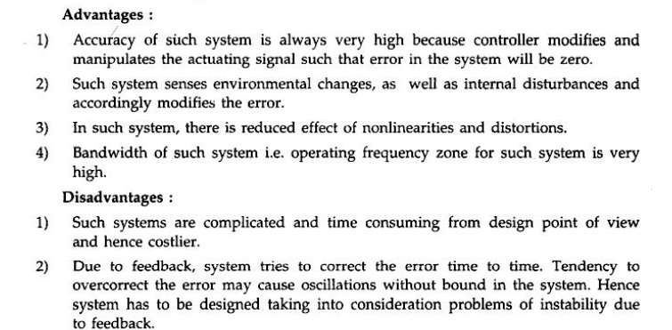
Closed loop system

Slide 14
has tendency to oscillate.
(a) Open loop system
(b) Closed loop system
(c) Both (a) and (b)
(d) Neither (a) nor (b)

Slide 15
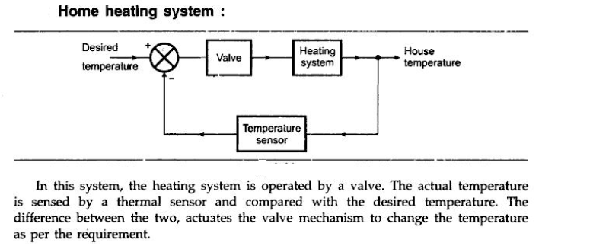
Example of Closed loop system

Slide 16
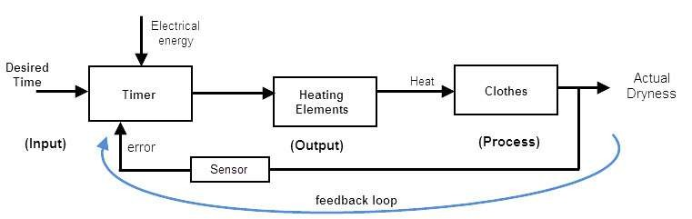
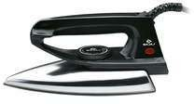
CLCS Examples
Automatic Electric Iron- Heating elements are controlled by output temperature of the iron.
16

Slide 17
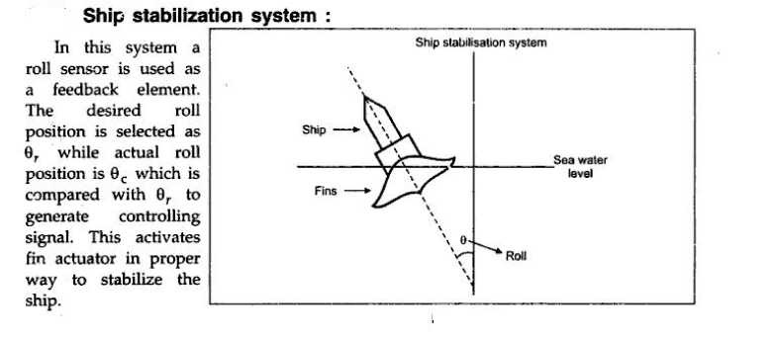

Slide 18
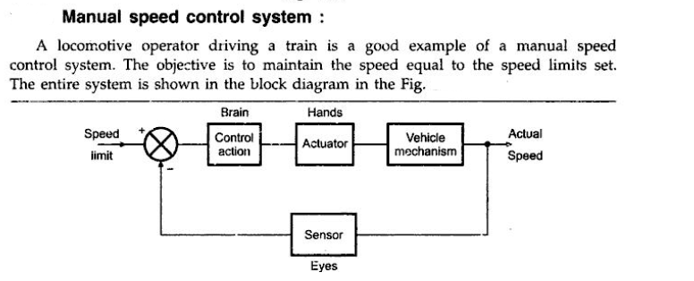
Example of Closed loop system

Slide 19
A car is running at a constant speed of 50 km/h, which of the following is the feedback
element for the driver ?
(a) Clutch
(b) Eyes
(c) Needle of the speedometer
(d) Steering wheel
(e) None of the above

Slide 20
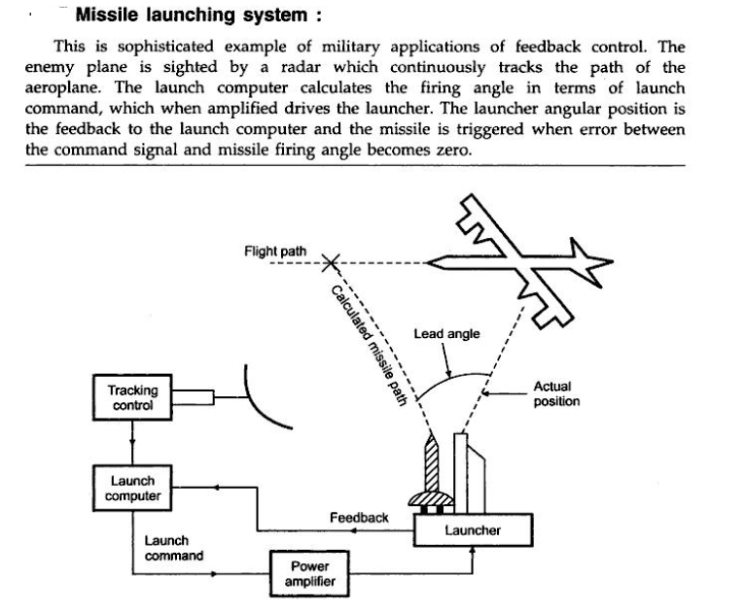

Slide 21
